Slide 1
Dependency Analysis for Kactus2
Joni-Matti Määttä, Mikko Honkonen,
Tommi Korhonen

Slide 2
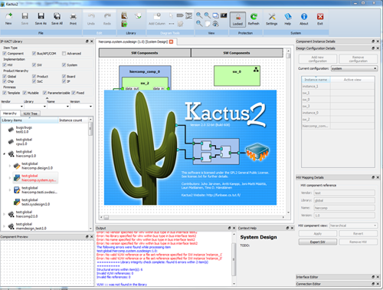
Background
Client: Timo Hämäläinen
Kactus2
Developed at TUT
Open-source toolset to design embedded products, especially FPGA-based MP-SoCs
Based on IP-XACT XML metadata and design methodology

Slide 3
Background 2
Implemented in C++ and Qt
Kactus2 goals
Easier IP reusability
Practical HW/SW abstraction for easier application SW development
The most user-friendly EDA tool
Handling file dependencies is essential for good usability

Slide 4
Problem
Both hardware and software projects include high amounts of files dependent on other files
Class instancing in C++
Component instances in VHDL
Not only strict code dependencies – for example a hardware component might be dependent on a block specification document
As project size increases, it becomes more and more difficult to keep track of these file dependencies
What files might a change in this file have an effect on?

Slide 5
Dependency Analysis Tool: Overview
Automates the file dependency tracking by scanning supported files and keeps track of file changes
The user should be able to see with one quick glance if a change has been made in a file another file depends on
As not all dependencies can be found automatically, user should also be able to specify dependencies manually
Automatic scan support initially planned for C, C++ and VHDL, but the system should be modular so that it is easy to implement additional file types

Slide 6
Dependency Analysis Tool: Features
Choosing and Managing Source Directories
Running Dependency Analysis
Manual Connections
Editing Existing Connections
Filtering Connections
External Dependencies

Slide 7
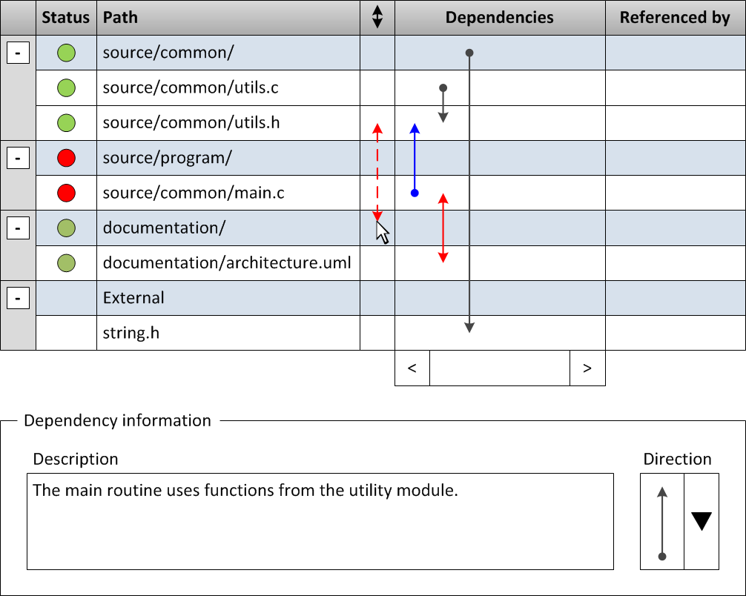
Dependency Analysis Tool: UI

Slide 8
Dependency Analysis Tool: Requirements
Must seamlessly integrate with Kactus2
Must be able to handle thousands of files
Without breaking
Within reasonable time
Must be easy to use

Slide 9
Project Group
3 group members
Joni-Matti: project manager, SW architect and developer
6th year student at TUT
Original member of the Kactus2 team
Over 10 years of experience in C++
Mikko: Test lead and development tasks
5th year student at TUT
Studies in both hardware and software
A good amount of experience in C++
Tommi: UI specialist and SW developer
5th year student at TUT
Studies in both hardware and software

Slide 10
Schedule
Estimated total time: 619 hours
Schedule for 2012
Planning and writing specification documents
Schedule for 2013
SW development and testing

Slide 11
Schedule 2012

Slide 12
Schedule 2013

Slide 13
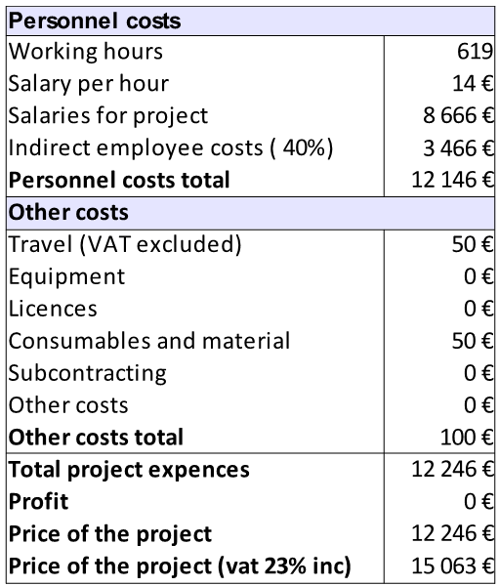
Budget (Imaginary)
No special equipment required
Salary costs the only major cost in the project
Any tools used also available for free or with free licensing for students
Some additional costs from travel (meetings at the university) and materials such as paper
Funding for the project would come from TUT

Slide 14
Project Management
Weekly meetings
Review of what has been done on the past week
Decisions what will be done on the next week
Open questions are addressed
Client meetings once in every two weeks
Especially important when making functional specification
Redmine
Free project management software
Centralized place for tasks, issues and time management

Slide 15
SWOT
Strengths
The project topic is quite simple and does not require too much special skills
All members have experience in C++
Joni-Matti has experience in other projects and project management
Weaknesses
Two members of the project group have only basic experience in Qt

Slide 16
SWOT 2
Opportunities
All team members learn new skills in project management and Qt development
If Kactus2 becomes popular, the dependency analysis tool will be well-known and used by many
Threats
Joni-Matti has multiple ongoing projects at the moment

Slide 17
Conclusion
The project has a strict scope
Good chances to get everything done in schedule
All members have enough skills to accomplish tasks
Large-scale learning not required during the project
The project results are immediately taken into use in Kactus2
Direct benefits for the community

